Slide 1
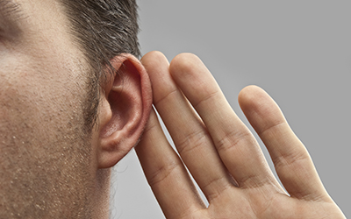
I Will Not Understand? (Mk. 4:12, Matt. 13:11-13)
I Hear Jesus Is Speaking In Parables… What Does This Mean For Me?
I Will Hear and See (Mk. 4:21-23)?

Slide 2
Parables…
“Para – bole” ( Beside – To Throw)
Physical reality coming to the side of a spiritual truth needed to be established.

Slide 3
Parables…
“Para – bole” ( Beside – To Throw)
Physical reality coming to the side of a spiritual truth needed to be established.
I heard Jesus speak parables to the woman at the well – “water of life” (Jn. 4:14)
I heard Jesus speak parables to his disciples – “fields white unto harvest (Jn. 4:35)
I heard Jesus speak parables to his disciples – make you “fishes of men” (Mk. 1:17)

Slide 4
Hearts of People are Closing…
Not seeing the clear signs in His miracles (Mk. 2:1-12)
Not seeing the purpose of His coming (Mk. 2:15-17)
Condemning the good done on the Sabbath (Mk. 3:23-28, 3:1-6)
Attributing Jesus’ miraculous power to the prince of demons (Mk. 3:20-30)

Slide 5
Can I who am “without” understand…?
I was with my fellows scribes and Pharisee – I could not help to see the power of Jesus argument and miraculous demonstration (Mk. 2:9-10)
I was in the synagogue when my friends were watching Jesus just to accuse Him, not believe in Him through the miraculous signs (Mk. 3:2)
I was in the house with my fellow scribes, and I could not answer how can Satan cast out Satan (Mk. 3:23)

Slide 6
Parables Same – I Turn
Turn again to be forgiven (Mk. 4:12, Matt. 13:15)
See the Light – Nothing is to be hid (Mk. 4:21-23)
Offer deeper insight into the spiritual truths of the Kingdom (Mk. 4:24-25)

Slide 7
Parables Same – I Turn
Turn again to be forgiven (Mk. 4:12, Matt. 13:15)
See the Light – Nothing is to be hid (Mk. 4:21-23)
Offer deeper insight into the spiritual truths of the Kingdom (Mk. 4:24-25)
Can you not see God’s love and grace for the Lost? (Lk. 15:1-32)

