Slide 1
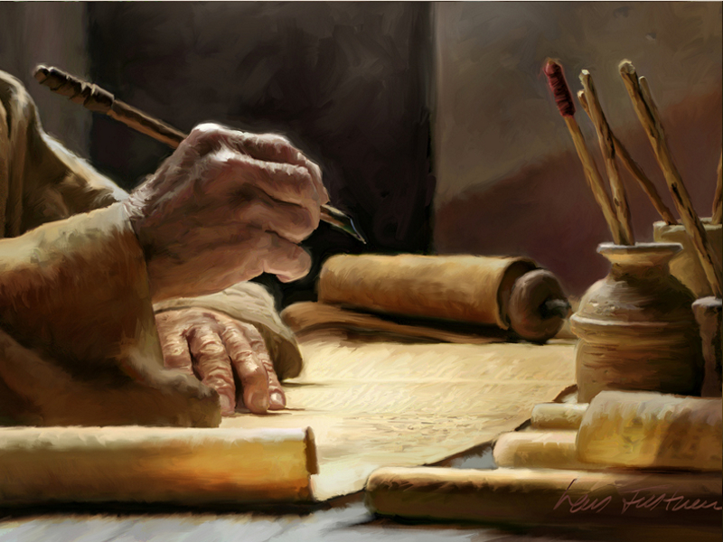
The Word And Worship

Slide 2
The Word and Worship
God’s Election… (Rom.11:11-12, 25-26, 28-32)

Slide 3
The Word and Worship
God’s Election… (Rom.11:11-12, 25-26, 28-32)
To Him Be The Glory (Rom. 11:33-36)

Slide 4
The Word and Worship
God’s Election… (Rom.11:11-12, 25-26, 28-32)
To Him Be The Glory (Rom. 11:33-36)
God’s Gospel …(I Tim. 1:11)

Slide 5
The Word and Worship
God’s Election… (Rom.11:11-12, 25-26, 28-32)
To Him Be The Glory (Rom. 11:33-36)
God’s Gospel …(I Tim. 1:11)
Honor and Glory Forever (I Tim. 1:12-17)

Slide 6
The Word and Worship
God’s Election… (Rom.11:11-12, 25-26, 28-32)
To Him Be The Glory (Rom. 11:33-36)
God’s Gospel …(I Tim. 1:11)
Honor and Glory Forever (I Tim. 1:12-17)
God’s New Birth …(I Pet. 1:3)

Slide 7
The Word and Worship
God’s Election… (Rom.11:11-12, 25-26, 28-32)
To Him Be The Glory (Rom. 11:33-36)
God’s Gospel …(I Tim. 1:11)
Honor and Glory Forever (I Tim. 1:12-17)
God’s New Birth …(I Pet. 1:3)
Blessed Be God (Psm. 96:2-3)

Slide 8
The Word and Worship
God’s Election… (Rom.11:11-12, 25-26, 28-32)
To Him Be The Glory (Rom. 11:33-36)
God’s Gospel …(I Tim. 1:11)
Honor and Glory Forever (I Tim. 1:12-17)
God’s New Birth …(I Pet. 1:3)
Blessed Be God (Psm. 96:2-3)
God’s Inheritance…(I Pet. 1:4)

Slide 9
The Word and Worship
God’s Election… (Rom.11:11-12, 25-26, 28-32)
To Him Be The Glory (Rom. 11:33-36)
God’s Gospel …(I Tim. 1:11)
Honor and Glory Forever (I Tim. 1:12-17)
God’s New Birth …(I Pet. 1:3)
Blessed Be God (Psm. 96:2-3)
God’s Inheritance…(I Pet. 1:4)
Blessed Be God (Psm. 103:2,4)

Slide 10
Written This Way…
The Word And Worship
Read It This Way!

