Slide 1
On the Right Side of History

Slide 2
The Kingdom
Last Enemy Abolished: death
“The end” does come
On the Right Side of History
I Corinthians 15:24-28
God all in all

Slide 3
The End Does Come…
Despite the Mockers – walking after their own lust (2 Pet. 3:3-4)

Slide 4
The End Does Come…
Despite the Mockers – walking after their own lust (2 Pet. 3:3-4)
Will come as a thief (2 Pet. 3:10)

Slide 5
The End Does Come…
Despite the Mockers – walking after their own lust (2 Pet. 3:3-4)
Will come as a thief (2 Pet. 3:10)
Right side of History Question - Living holy and godly lives (2 Pet. 3:11)

Slide 6
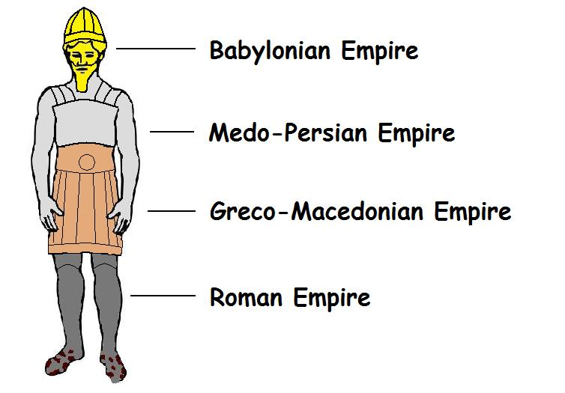
The Kingdom Comes (Dan. 2:44-45, Heb. 12:23,28)
Daniel’s Prophecy: Dan. 2: 36-43
606-539 B.C.
539-331 B.C.
331- 30 B.C.
30 B.C. -397 A.D.

Slide 7
Jesus Comes (Gal. 4:4)
Born of Woman
Genesis 3:15
Born under Law
Matthew 5:18
To Redeem
I Pet. 1:18-19

Slide 8
Jesus Returns…
Death Abolished (Jn. 5: 28-29)
Universal Judgment (Jn. 5:27, 2 Cor. 5:10, Jn. 12:48)

Slide 9
Jesus Returns…
Death Abolished (Jn. 5: 28-29)
Universal Judgment (Jn. 5:27, 2 Cor. 5:10, Jn. 12:48)
Eternal Life in Heaven – Eternal Punishment in Hell (I Pet. 1:4; Mk. 10:43, 48)

Slide 10
Jesus Returns…
Death Abolished (Jn. 5: 28-29)
Universal Judgment (Jn. 5:27, 2 Cor. 5:10, Jn. 12:48)
Eternal Life in Heaven – Eternal Punishment in Hell (I Pet. 1:4; Mk. 10:43, 48)
Whom are you hearing, heeding, obeying now? (Jn. 5:25, 2 Thess. 1:8-9)

Slide 11
The Kingdom – In the church now!
Last Enemy Abolished: death – Heeding the Voice of Jesus Now!
“The end” does come – Holy Living Now!
Will You Be On the Right Side of History?
Heaven
Universal Judgment
Hell

