Slide 1
GOD-CENTERED NOT MAN-FOCUSED

Slide 2
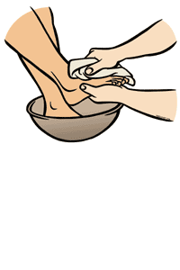
GOD-CENTERED NOT MAN-FOCUSED
Service

Slide 3
GOD-CENTERED NOT MAN-FOCUSED
Humbly Serving

Slide 4
HUMBLY SERVING
Acts 20:19 serving the Lord with all humility…

Slide 5
HUMBLY SERVING
What We Do
How We Do It

Slide 6
HUMBLY SERVING
What We Do
an act of helpful activity; help; aid: to do someone a service

Slide 7
HUMBLY SERVING
marked by meekness or modesty in behavior, attitude, or spirit; not arrogant or prideful
How We Do It

Slide 8
HUMBLY SERVING
The Christian Life Is One Of Service
Christ’s Teaching
Matthew 6:24; 20:20-27
Christ’s Example
Mat.20:28; 1 Pet.2:21-25

Slide 9
HUMBLY SERVING
Christian’s Attitude Is One Of Humility
Christ’s Teaching
1 Pet.5:5; Lk.10:16; 17:7-10
Christ’s Example
John 13:3-17; Phil.2:4-8

Slide 10
1 Corinthians 11:1 - Imitate me, just as I also imitate Christ.
Paul Was God-Centered Not Man-Focused: Humbly Serving GOD & Fellow Man
Are We Imitating Christ In Serving Others Humbly?

