Slide 1
Did Jesus actually live according to secular history?
What Do Ancient Non-Christian Writers say about Christ?

Slide 2
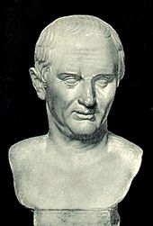
Nero fastened the guilt . . . on a class hated for their abominations, called Christians by the populace. Christus, from whom the name had its origin, suffered the extreme penalty during the reign of Tiberius at the hands of . . . Pontius Pilatus, and a most mischievous superstition, thus checked for the moment, again broke out not only in Judaea, the first source of the evil, but even in Rome. . . (Annals 15. 44)
Tacitus
A.D. 116

Slide 3
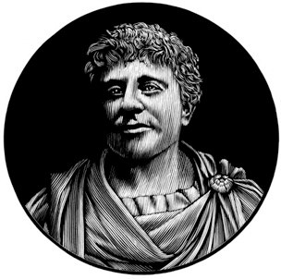
They were in the habit of meeting on a certain fixed day before it was light, when they sang in alternate verses a hymn to Christ, as to a god, and bound themselves by a solemn oath, not to any wicked deeds, but never to commit any fraud, theft or adultery, never to falsify their word, nor deny a trust when they should be called upon to deliver it up; after which it was their custom to separate, and then reassemble to partake of food--but food of an ordinary and innocent kind.
Pliny the Younger
A.D. 61 - 112

Slide 4
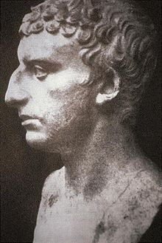
About this time there lived Jesus, a wise man, if indeed one ought to call him a man. For he . . . wrought surprising feats. . . . He was the Christ. When Pilate . . .condemned him to be crucified, those who had . . . come to love him did not give up their affection for him. On the third day he appeared . . . restored to life. . . . And the tribe of Christians . . . has . . . not disappeared.
Josephus
A.D. 37-100
(Antiquities 18.63-64)

Slide 5
(Habermas, The Historical Jesus, 194). The passage reads as follows: "At this time there was a wise man who was called Jesus. His conduct was good and (he) was known to be virtuous. And many people from among the Jews and the other nations became his disciples. Pilate condemned him to be crucified and to die. But those who had become his disciples did not abandon his discipleship. They reported that he had appeared to them three days after his crucifixion, and that he was alive; accordingly he was perhaps the Messiah, concerning whom the prophets have recounted wonders." (Quoted in James H. Charlesworth, Jesus Within Judaism, (Garden City: Doubleday, 1988), 95, cited in Habermas, The Historical Jesus, 194).

Slide 6
On the eve of the Passover Yeshu was hanged. For forty days before the execution took place, a herald . . . cried, "He is going forth to be stoned because he has practiced sorcery and enticed Israel to apostasy."
The Babylonian Talmud, transl. by I. Epstein (London: Soncino, 1935), vol. III, Sanhedrin 43a, 281, cited in Habermas, The Historical Jesus, 203.

Slide 7
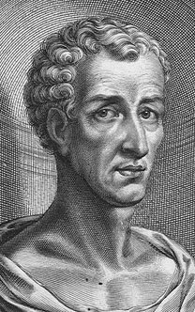
The Christians . . . worship a man to this day--the distinguished personage who introduced their novel rites, and was crucified on that account. . . . [It] was impressed on them by their original lawgiver that they are all brothers, from the moment that they are converted, and deny the gods of Greece, and worship the crucified sage, and live after his laws.
Lucian
A.D. 125-180

Slide 8
Non-Christian Sources For Jesus
Jesus was wise – sage (Josephus, Lucian)
Powerful, revered teacher (Pliny, Talmud, Lucian)
Miraculous Deeds attributed to Jesus (Josephus, Talmud)
Jesus was crucified – Pontius Pilate - Passover (Tacitus, Josephus, Talmud, Lucian)
Possible references of Followers’ belief in Jesus’ resurrection (Tacitus, Josephus)
Followers believe Jesus is Christ – Messiah (Josephus)
Christians worshiped Jesus as God (Pliny, Lucian)

