Slide 1
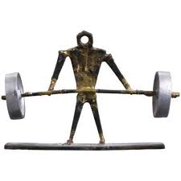
“Be Strong In The Lord…”
Hebrews 13:9
Ephesians 6:10, 14-17

Slide 2
Jewish Inspired – “They” (Heb. 13:10)
divers and strange doctrines
Romans 14 – Col. 2:16???
Grace
Not
Meats
Acts 20:32
Mk. 7:3, 18-19???
Not Profited though Occupied

Slide 3
Heart Established By Grace
Partake of “altar” (Heb. 13:10-11) – Death of Christ Vs. Old Law – Sin Offering (cf. Lev. 4:12)
Suffer with Christ “outside the gate” –” we seek after “the city” that is to come” (Heb. 13:13-14, Heb. 10:34, 11:16, 2 Pet. 3:12-13)
Jesus is the same – don’t be carried away by false doctrine (Heb. 13:8, Gal.1: 6-7, Jude 3, Eph. 4:13-15)

Slide 4
Heart Established By Grace
Remember those who died connected with the word – “Consider the issue of their life” - “imitate their faith” (Heb. 13:7)
Be free from love of money - Content - God will not fail You (Hebrews 13:5, Deut. 31:6)
Offer Sacrifice to God and man – Through Christ (Heb. 13:15-16)
Praise to God – confessing His name
Do good to and sharing with others (Heb. 13:3, I Tim. 6:18-19)

Slide 5
“Strengthened in Grace”
Distinct and Unchanging Doctrine of Christ!
God does not fail you when money does!
We have a better city to seek!
Continue to Praise God’s authority – and help others out of compassion!
Consider the life of faithful dead – imitate their faith!

